Slide 1
  Sample Code

Slide 2
Basic Selenese Commands
Initiating the Web Browser
  When launching the web browser use the following commands:
  Example:
  Firefox: WebDriver driver = new FirefoxDriver();
  Chrome: WebDriver driver = new ChromeDriver();
  IE: WebDriver driver = new InternetExplorerDriver();
Fetching a Page
  When navigating to a page you use the “get” command.
  Example:
  driver.get("http://www.google.com");
  driver.navigate().to(" http://www.google.com");

Slide 3
Basic Selenese Commands (Cont..)
Closing a Browser
  When closing the web browser you use the “quit” command.
  Example:
  driver.quit();
Locating a Web Element
  When finding for a web element you use the “findElement” command.
  Example:
  WebElementelement = driver.findElement(By.id(“sampleElement"));

Slide 4
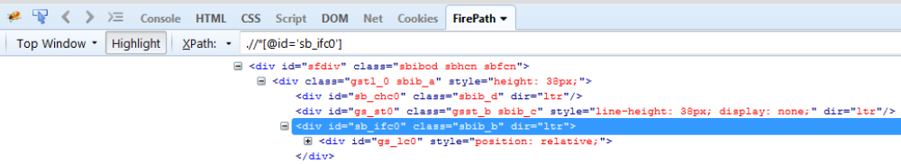
Basic Selenese Commands (Cont..)
ByID
  This is the most efficient and preferred way to locate an element.
  Example:
  WebElementelement = driver.findElement(By.id(“sb_ifc0"));

Slide 5
Basic Selenese Commands (Cont..)
By Class Name
  This refers to the attribute on the DOM element
  Example:
  WebElementelement = driver.findElement(By.className(“sbib_b"));

Slide 6
Basic Selenese Commands (Cont..)
By Tag Name
  The DOM Tag Name of the element.
  Example:
  WebElementelement = driver.findElement(By.tagName(“div"));

Slide 7
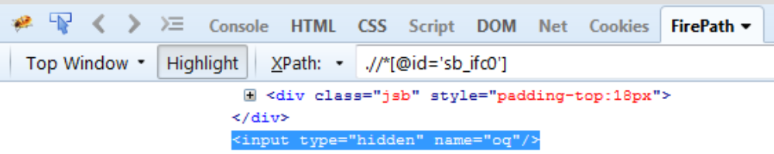
Basic Selenese Commands (Cont..)
By Name
  Find the input element with matching name attribute.
  Example:
  WebElementelement = driver.findElement(By.name(“oq"));

Slide 8
Basic Selenese Commands (Cont..)
By Link Text
Find the link element with matching visible text.
Example:
WebElementelement = driver.findElement(By.linkText(“Selenium Downloads"));
By Partial Link Text
Find the link element with partial matching visible text.
Example:
WebElementelement = driver.findElement(By.partialLlinkText(“Selenium"));

Slide 9
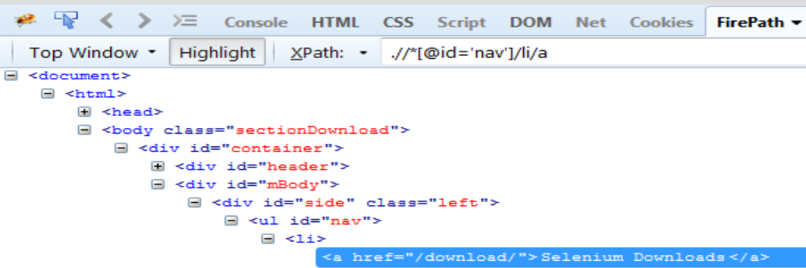
Basic Selenese Commands (Cont..)
By CSS (Cascading Style Sheet)
  Like the name implies it is a locator strategy by css. Beware that not all browsers were created equal, some css that might work in one version may not work in another.
  Example:
  WebElementelement = driver.findElement(By.cssSelector(“#input.sampleElement"));

Slide 10
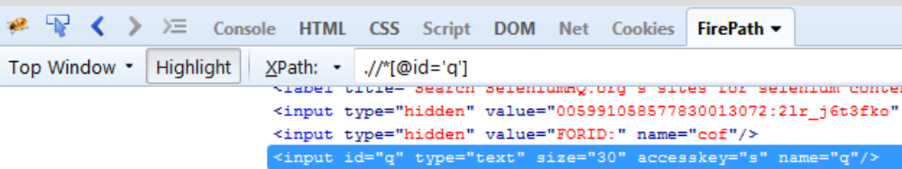
Basic Selenese Commands (Cont..)
By Xpath
  WebDriver uses a browser’s native XPath capabilities wherever possible. On those browsers that don’t have native XPath support, we have provided our own implementation. This can lead to some unexpected behaviourunless you are aware of the differences in the various xpathengines.
  Example:
  WebElementelement = driver.findElement(By.xpath(“//input"));

Slide 11
Basic Selenese Commands (Cont..)
Typing a value
  When entering a value to a textbox you use the “sendKeys” command.
  Example:
  WebElementelement = driver.findElement(By.name("q"));
  element.sendKeys("Cheese!");
Clicking an Element
  When clicking a web element you use the “click” command.
  Example:
  WebElementelement = driver.findElement(By.xpath(“//smpleElem"));
  element.click();

Slide 12
Basic Selenese Commands (Cont..)
Selecting a value from Dropdown
  When selecting a value from a dropdown you use this commands:
  Example:
  Select select= new Select(driver.findElement(By.tagName("select")));
  select.selectByVisibleText("Edam");
  Select select= new Select(driver.findElement(By.tagName("select")));
  select.selectByIndex(1);

